Slide 1
Back to School Night
Carrie Hamilton
Study Skills
Transition Partnership Program
Introduction to Foreign Language

Slide 2
Study Skills
2nd Period
COURSE DESCRIPTION
The Study Skills class is designed to:
Provide additional support for academic classes
Familiarize students with various learning styles
Teach organizational skills
Help students become advocates for themselves
There will also be opportunities for the students to work on career and college education exploration.
Aide Support
Sarah Campagna

Slide 3
Introduction to Foreign Language 5th Period
Spanish, Italian, German, French, other
Read from textbook and take notes
DuoLingo
Geography

Slide 4
Transition Partnership Program ^{4th} Period
Murrieta Valley Unified School District (VMHS)
Carrie Hamilton
Department of Rehabilitation
Diana Reyes
Riverside County of Education
Shelli Wozolek

Slide 5
Student Services If plan “A” fails, there are 25 other letters in the alphabet
Job Exploration Counseling | Workplace Readiness Training | Work Experience | Self-Advocacy | Post Secondary Counseling
Explore Career interests In Demand Jobs Career Pathways | Interviewing Techniques Resume Building Relevant Work Practices Money Management | Paid/Unpaid Work Experience Job Shadowing Work-Place Tours Guest Speakers | Disability Understanding and Disclosure Career Goal Setting Requesting Accommodations | Post Secondary Options Educational Resources and Disability Support Services Application and Enrollment Process

Slide 6
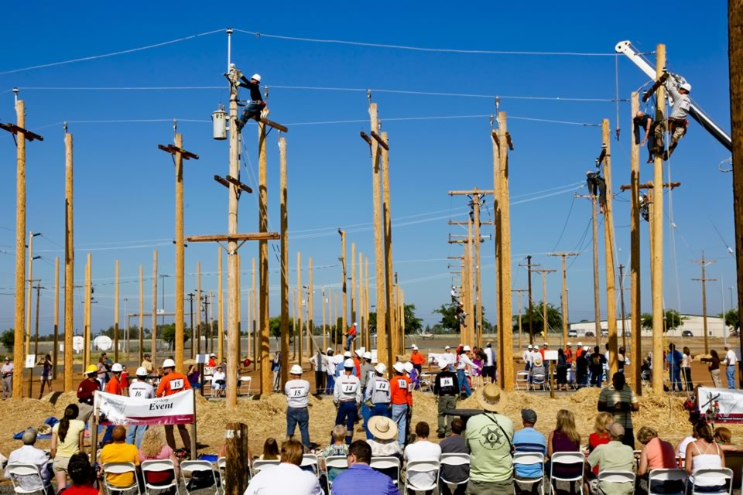
Potential Services After High School
On the Job Training | Job Placement Assistance | Career Counseling and Assessments | Transportation Funds, Employment Tools, and Supplies

Slide 7
Contact Information Please do not hesitate to contact me with any questions, concerns, or support. Email is the first means of contact. If needed, we can set up a virtual meeting during office hours.
Email | chamilton@murrieta.k12.ca.us
Phone | 951-894-5750 Ext: 6634 Email is preferred method to contact me

Slide 8
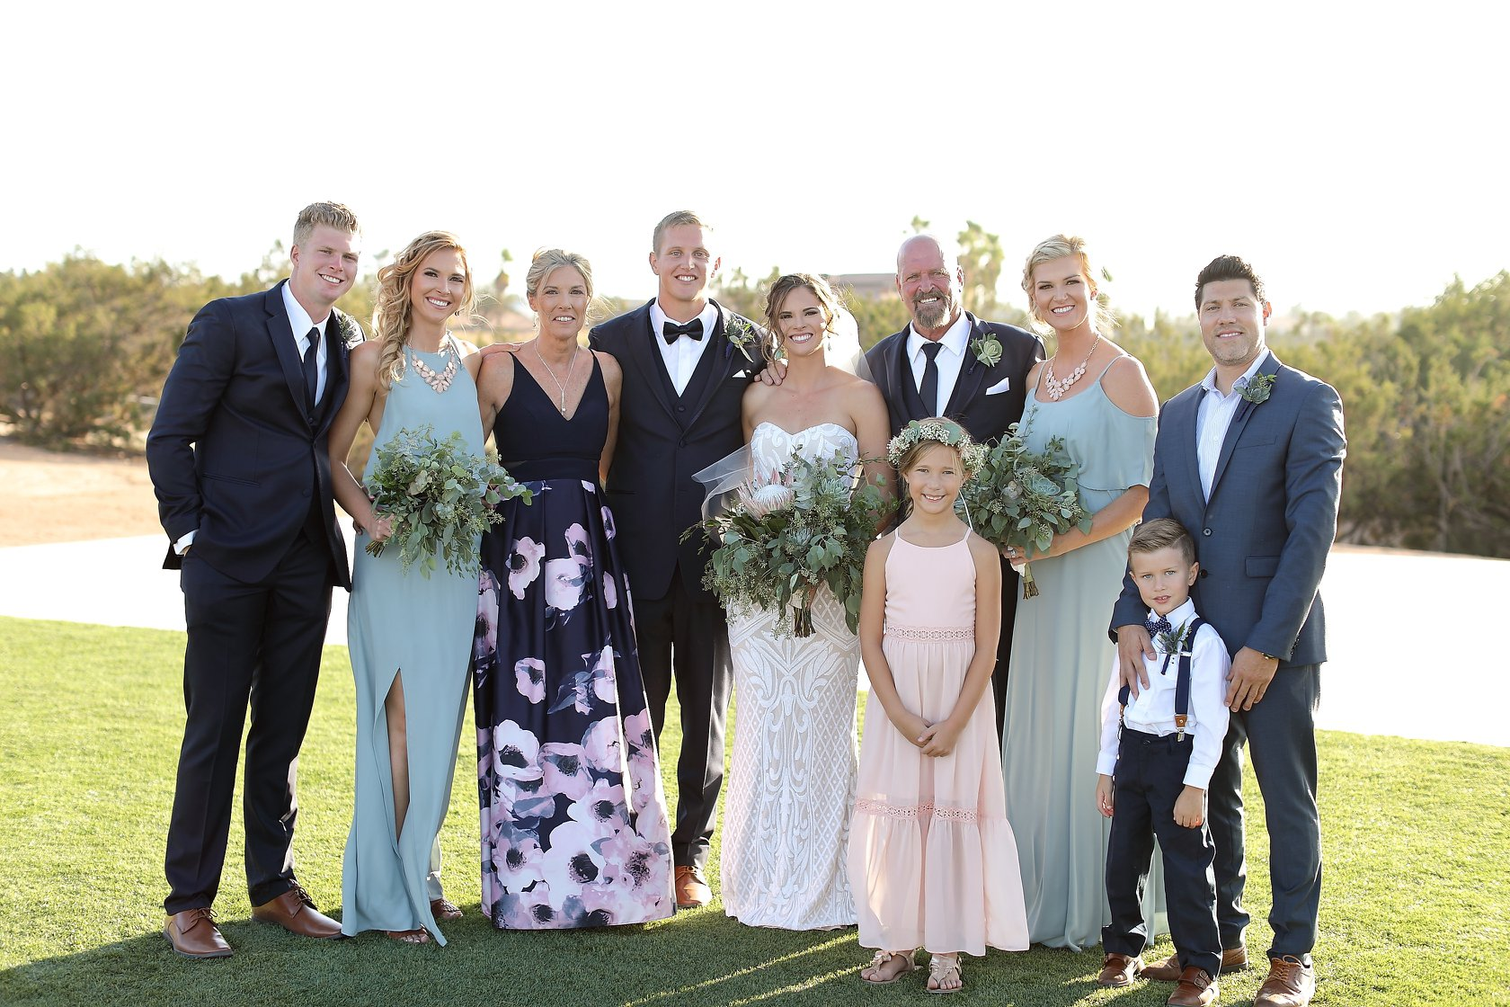

Slide 9
Thank you

